Slide 1
Next Generation QA & Testing using Machine Learning / AI
CRESTA
September 2017

Slide 2







Quality Assurance & Testing Services Overview
Up to 80% software test automation to improve productivity
Combination of 40+ Industry Solutions and Tools / Accelerators
Up to 100% improvement in quality
Up to 40% reduction in overall testing costs
Up to 50% faster time-to-market
Strong industry recognition by leading analysts
MODEL
^{Digital Business Assurance}
AUTOMATE
^{Dev “Test” Ops}
^{Intelligent Quality Assurance}
^{Digital Asset Reliability}
^{Value Driven Quality Assurance}
INTEGRATE
TRANSFORM
Automation Platforms
Open2Test, T3A
CRESTA
U-RACE
CUE²
CFFSM
TDMS
QuanTM
IntelliPERF
IntelliTEST
Notes:
QAT is an integral enabler for digital transformation. “Testing” combined with “Quality Assurance” deals with the evolution of verification & validation into business assurance. Our key services include the following:
Digital Business Assurance: Evolve from verification & validation of functional specifications to providing assurance of business process models in the digital context
Dev “Test” Ops: QAT is the invisible but critical function in the Agile / Devops lifecycle by providing tools and solutions for enabling continuous integration and continuous delivery
Intelligent QA: “Shifting Right” to derive meaningful insight for decision making based on self learning AI/machine learning techniques specific to QAT
Digital Asset Reliability: Provide assurance for performance, security, test data, and test environment driving increasing reliability for the organization’s critical digital assets
Managed Services: Next generation outcome based delivery models for QAT services that enable greater transparency, flexibility and effective risk management
Some of our key successes towards exceeding outcomes are:
Automation – we have been able to save more than 50% cost while improving productivity significantly by automating almost 100% of the regression test scope (over 3500) SAP scripts for a large bank in Latin America
Our testing accelerator for Insurance helped reduce cost by 30% - this is one of the 40+ industry specific solutions we have developed and continue to evolve
Production defects for a healthcare client reduced by 100% over a period of 1 year after NTT DATA was involved in testing the application through rigorous focus on coverage, comprehensive test design and meticulous test management.
Our engagement with a leading Manufacturing client helped reduce overall costs up to 40% while improving go to market by 50%.

Slide 3
Market Trends: Evolving from Verification & Validation to Business Assurance
Agile and DevOps
Continuous Delivery – BDD, TDD, ATTD
Increased Test Automation (up to 80%)
Convergence with performance and security testing (especially with mobile)
Multi competency focus
Functional and non functional shift left
Unit testing from 50-60% to 100% for new custom code development
Simulation and service virtualization will embed itself in dev-testing
Manual will become all exploratory testing (no more than 10-20% total testing)
Shift right
AI / ML based Test Optimization, Automation, Defect Prediction, Defect Prevention
Automation
GUI automation will decrease substantially in favor of API testing
Business Process & Instance based
Scriptless, Touchless (Self Healing)
Visual based testing
End to End – Ecosystem wide
TCoE Transformation:
Federated and capability oriented
Alignment with industry domains
Support federated teams, self managing teams, more integrated with AGILE PM.
Reporting will include growing analytics
Stable practices for Test Data Management, Test Environment Management

Slide 4





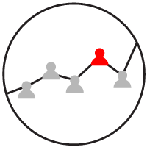
Differentiating Strategies to Address Dramatically Changing Needs
Compliance, Growth & Profit.
Experience, Growth
Experience, Value Generation
All
All
Digital Business Assurance
Dev “Test” Ops
Intelligent QA
Digital Asset Reliability
Value Driven Quality Assurance
Identify, map and validate business processes
Compliance Monitoring
Market Readiness
Design test first, code later
Continuous Integration / Continuous Delivery
Expand scope
Predictive analytics from historical test assets
Optimize test suite and coverage
Performance Testing
Security Testing
Infrastructure Testing
TDM, TEM
Remote mobility
Collaborate to build centralized, federated or virtual COEs
Outcome based full service models
Solution
TDO, Uptimizer, Hotpac Analyzer, QCertify
Payment Engine
EBT, Customer Friction Factor
ATDD, BDD, TDD, T3A, O2T, Robot Automation Frameworks
Collaborative Continuous Delivery
CRESTA (Machine Learning)
NLP, Text Analytics, Real Time QA
LISA, Remote TestKit
NTT DATA Intelliperf
NTT DATA TDMS
Maturity Benchmarking
Testing As A Service
NTT DATA QUANTM
Tools
Improved conformance, reduced risk
Reduced effort, time to deployment
Improved quality, Reduced time to deployment
Reduced time to deployment
Reduced cost, risk
Benefits

Slide 5

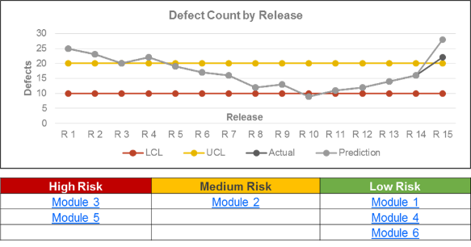
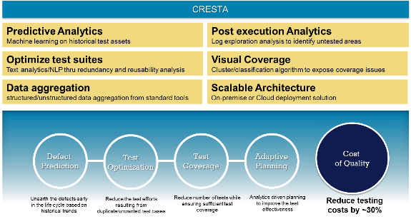

Using Artificial Intelligence to Drive Risk Management & Optimization
CRESTA (Comprehensive Robotic Engine for Software Test Acceleration) - An innovative analytics driven testing engine leveraging intelligent robotic automation technologies such as Machine Learning, Test Analytics and Natural Language Processing
Sample Defect & Risk Prediction
Case Study
Customer : American multi national banking and financial services corporation
User base : ~23 Million bank customers
Service offering : Test Automation, Mobile Testing, Machine Learning
Outcome : ~95% prediction accuracy of defects. Automated process of project estimation, risk analysis and budgeting through adaptive planning
Powered By
Jubatus is the first open source platform for online distributed machine learning on the data streams of Big Data developed by NTT
Identify potential quality gaps prior to the release
Reduce number of tests while increasing coverage
Analytics driven planning to improve the test effectiveness
Comprehensive Dashboarding / Reporting
Benefits
(1) For more details you can view this webinar. (2) Our blog on Cresta is here .

Slide 6


CRESTA – Use Cases
 | Situation | Solution | Benefit
1 | Which Modules are defective and are more likely to result in customer dissatisfaction ? | A tool that can consolidate all the test management / defect data and predict the health of all the modules | Improve Quality
2 | What are the minimum number of test cases that can be executed with out increasing risk? | A tool that can analyze test cases provide reports on duplicate test cases that can be retired without risking product quality | Reduce Risk
3 | Are Test cases well written? Do they match up with the requirements? | A tool that can scan all the test cases and compare them to requirements intelligently | Faster Cycle Time
Typical Outcomes
Achieve initial accuracy levels of ~90% involving limited data sets from HP ALM (Application Life Cycle Management)
Gradually improve the accuracy of prediction to 95% by building relevant data dictionaries and fine tuning the algorithms
Optimize the test coverage by eliminating redundant test cases in regression suites resulting in ~30% effort savings per cycle
A scalable solution that can be deployed across the enterprise to achieve greater efficiency and effectiveness in testing.
Coming soon…
4 | How much budget is needed to complete an upcoming release? What are the options to contain cost with out compromising quality? | A tool that can intelligently predict budget, schedule, effort etc. to help the management in decision making | Increase Effectiveness

Slide 7
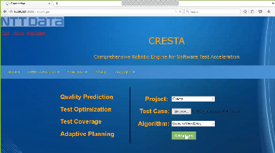
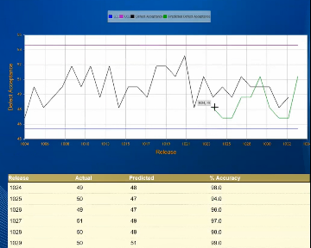
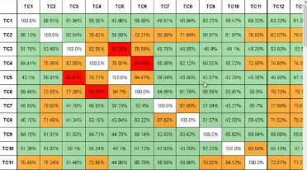
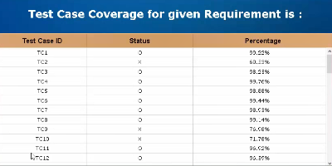
Product Features
Key Features
Web based UI is responsive and can be accessed anywhere within NTT DATA
Built ground up for QA based use cases
Integrates with HP QC / ALM, QuanTM, MySQL, Redmine, Excel, etc to import test cases, project data, test management data
Uses latest technologies like R, Python, Django, Ace for importing, processing & presenting data
Leverages Jubatus for self learning ML for predictive analytics, Gensim and other tools for Natural Language Processing
Extensible APIs can be leveraged for any custom integration (such as Qlikview for one client implementation)
Product quality prediction accuracy can be as high as 95%
Traceability to requirements helps increase the quality of testing
Redundancy identification is easy and can be combined with traditional risk based testing to make testing efficient
Live demo recording link is here

Slide 8
Advanced Use Cases for CRESTA
Optimize Coverage for
Automation Test Scripts
Relate Objects
to Automation Scripts
Relate Java Code
Files Objects
Script_1
Script_2
Script_1
Email
C_1_Email
Identify Optimum
Scripts
Script_2
ReadData
C_2_Email
Script_3
Date
C_3_Email
Script_3
Script_3
Port
C_4_Email
Reopen Regression Defects based on error Logs
Script_4
Packet
C_1_ReadData
Script_5
Script_6
RoutingIP
C_2_ReadData
Defect_1
Error_Obj_1
Automation Scripts
Test Objects or
Functional Areas
Code Scripts
Defect_2
Error_Obj_2
Env_1
Identify Test Scripts to run… based on Code Files changed.
Env_2
Error_Obj_1
ScriptIssue_1
ScriptIssue_2
Error_Obj_2

